Slide 1

Introduction to Information Systems ITISA1

Slide 2


Disclaimer
Please note that the content made available on myLMS may deviate slightly from what is covered in lecturer-led sessions. However, the material on myLMS, along with prescribed textbooks and any other designated learning resources, constitutes the compulsory content students are expected to consult and prepare for assessments.

Slide 3
What will be covered in the rest of today’s session?
What will be covered in the lecture-led session:
Enterprise Systems
Transaction Processing Systems
TPSs Example

Slide 4
Why Enterprise Systems ?
Perform routine business processes and maintain records about them
Support a wide range of business activities: supply chain management, customer relationship management, and product lifecycle management

Slide 5
Transaction Processing Systems
Transaction processing systems (TPSs)
Capture and process detailed data to update records about fundamental business operations
Order entry, inventory control, payroll, accounts payable, accounts receivable, general ledger, etc.
Provide valuable input
Management information systems
Decision support systems
Knowledge management systems

Slide 6
Traditional Transaction Processing Methods and Objectives
Batch processing system
Business transactions are accumulated over a period and prepared for processing as a single unit or batch
Essential characteristic: delay between event and processing of related transaction to update records
Online transaction processing (OLTP)
Each transaction is processed immediately
Data in an online system reflects current status
Many find OLTP enables faster, more efficient service

Slide 7
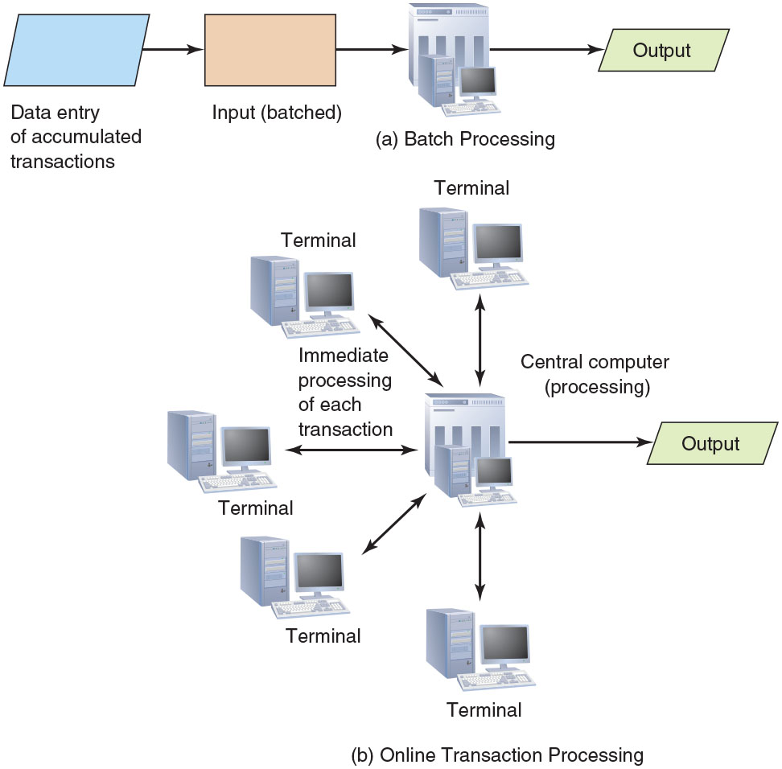
Traditional Transaction Processing Methods and Objectives
FIGURE 10.2
Batch versus online transaction processing
(a) Batch processing inputs and
processes data in groups. (b) In
online processing, transactions are
processed as they occur.

Slide 8
Traditional Transaction Processing Methods and Objectives
Organizations expect TPSs to:
Capture, process, and update databases
Ensure data is processed accurately and completely
Avoid processing fraudulent transactions
Produce timely user responses and reports
Reduce clerical and other labor requirements
Help improve customer service
Achieve competitive advantage

Slide 9
TPSs Examples
TPS systems
Order processing systems
Accounting systems
Purchasing systems
Stock Exchanges – Add more examples…

Slide 10
Transaction Processing Activities
Transaction processing cycle
Data collection
Data editing
Data correction
Data processing
Data storage
Document production

Slide 11
Data Collection
Capturing and gathering all data necessary to complete the processing of transactions
Data collection can be manual or automated via special input devices
Source data automation
Capturing data at its source and recording it accurately in a timely fashion with minimal manual effort and in an electronic or digital form so it can be directly entered into the computer

Slide 12
Data Collection
Cloud-based POS systems provide a range of capabilities
Advanced integration with digital loyalty programs
Various accounting tools
Ability to generate gift cards and coupons

Slide 13
Data Editing
Data editing
Checking data for validity and completeness to detect any problems
Examples
Quantity and cost data must be numeric
Names must be alphabetic
Codes associated with an individual transaction are edited against a database containing valid codes

Slide 14
Data Correction
Systems should provide error messages that alert those responsible for editing the data
Should specify the problem so proper corrections can be made
Data correction involves reentering data that was not typed or scanned properly

Slide 15
Data Processing
Performing calculations and other data transformations related to business transactions
Classifying data
Sorting data into categories
Performing calculations
Summarizing results
Storing data in the organization’s database for further processing

Slide 16
Data Storage
Involves updating one or more databases with new transactions
After being updated, this data can be further processed and manipulated by other systems

Slide 17
Document Production
Generating output records, documents, and reports
Hard-copy paper reports or displays on computer screens (soft copy)
Results from one TPS can become input to another
Most TPSs provide other useful information
Reports that help perform various activities (e.g., inventory) and those required by local, state, and federal agencies

Slide 18
Activity
What is a Transaction Processing System (TPS), and how does it differ from other types of information systems?
Why are TPSs considered mission-critical in many organizations?
What are the different types of transactions handled by TPS (e.g., batch vs. real-time)? Give examples.
How do the components of a TPS (input, processing, storage, output, control) interact to ensure data integrity?
How has the emergence of cloud computing impacted the design and deployment of TPS?

Slide 19
What will be covered in the rest of today’s session?
What will be covered in the lecture-led session:
Enterprise systems
Supply chain management
Product lifecycle management

Slide 20
Enterprise Systems

Slide 21
Enterprise Systems
An enterprise system is central to individuals and organizations of all sizes
Ensures information can be shared across all business functions and all levels of management to support running and managing of a business

Slide 22
Enterprise Systems
Businesses rely on enterprise systems to perform daily activities in areas such as:
Product supply and distribution
Sales and marketing
Human resources
Manufacturing
Accounting
Taxation

Slide 23
Enterprise Resource Planning
Enterprise resource planning (ERP)
Set of integrated programs that manage a company’s vital business operations for an entire organization
Business process
Set of coordinated and related activities that takes one or more kinds of input and creates an output of value to the customer of that process

Slide 24
Advantages of ERP
Improved access to quality data for operational decision making
AI-generated insights and the human-machine learning partnership
Elimination of costly, inflexible legacy systems
Improvement of work processes
Opportunity to upgrade and standardize technology infrastructure

Slide 25
ERP Systems
ERP systems are commonly used in manufacturing companies, colleges and universities, professional service organizations, retailers, and healthcare organizations
The business needs for each of these types of organizations vary greatly
No one ERP software solution from a single vendor is “best” for all organizations

Slide 26
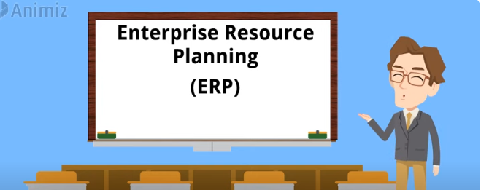
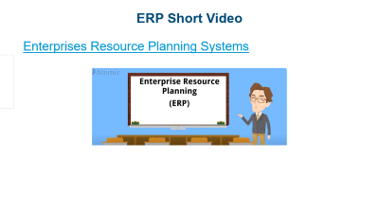
ERP Short Video
Enterprises Resource Planning Systems

Slide 27
Supply Chain Management (SCM)
System that includes planning, executing, and controlling all activities involved in:
Sourcing and procurement of raw materials
Converting raw materials to finished products
Warehousing and delivering finished product to customers

Slide 28
Supply Chain Management (SCM)
Process for developing a production plan:
Sales forecasting
Sales and operations plan (S&OP)
Demand management
Detailed scheduling
Materials requirement planning (MRP)
Purchasing
Production
Sales ordering

Slide 29
Supply Chain Management (SCM)
ERP systems do not work directly with production machines
Data must be passed to the ERP accounting modules to keep an accurate count of finished product inventory
Production quality data can be added based on the results of quality tests run on each batch of product produced
Typically includes the batch identification number

Slide 30
Customer Relationship Management (CRM)
Helps a company manage all aspects of customer encounters
Marketing, sales, distribution, accounting, and customer service
Goal is to understand and anticipate needs of current and potential customers
Used primarily in sales, marketing, and service organizations
Capture and view data about customers and improve communications

Slide 31
Customer Relationship Management (CRM)
Key features of a CRM system
Contact management
Sales management
Customer support
Marketing automation
Analysis
Social networking
Access by mobile devices
Import contact data

Slide 32
Customer Relationship Management (CRM)
Due to the popularity of mobile devices, shoppers can easily compare products and prices on their mobile phones
Can also tweet experiences with a brand to dozens of friends
Savvy retailers use their CRM systems to stay on top of what these customers are saying on social networks

Slide 33
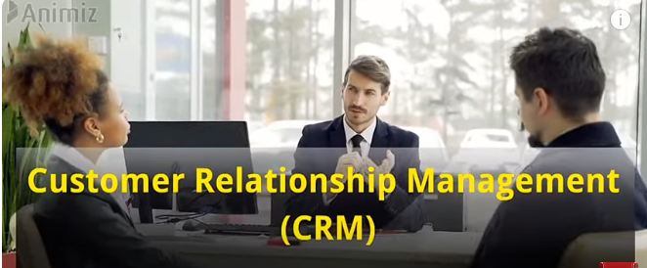
CRM systems short Video
Customer Relationship Management Systems

Slide 34
Product Lifecycle Management (PLM)
Enterprise business strategy that creates a common repository of product information and processes
Supports collaborative creation, management, dissemination, and use of product and packaging definition information
Product lifecycle management software
Provides a means for managing data and processes associated with various phases of the lifecycle of a product

Slide 35
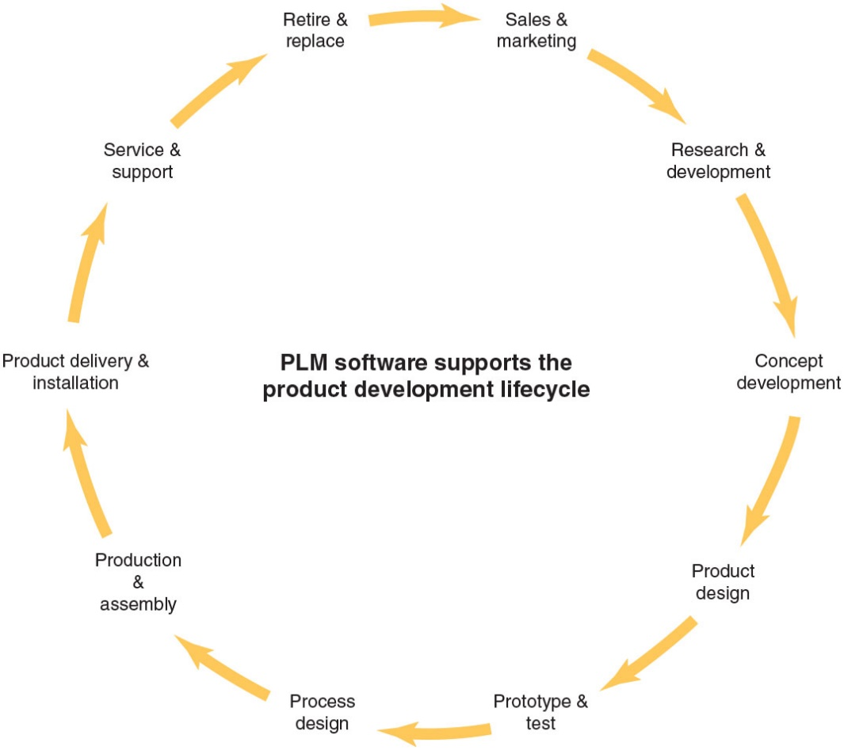
Product Lifecycle Management (PLM)
Scope of PLM software
Using PLM software, organizations can manage the data and processes associated with the various phases of the product lifecycle.

Slide 36
Product Lifecycle Management (PLM)
Computer-aided design (CAD)
Use of software to assist in creation, analysis, and modification of the design of a component or product
Computer-aided engineering (CAE)
Use of software to analyze the robustness and performance of components and assemblies
Computer-aided manufacturing (CAM)
Use of software to control tools and machinery in manufacture of components

Slide 37
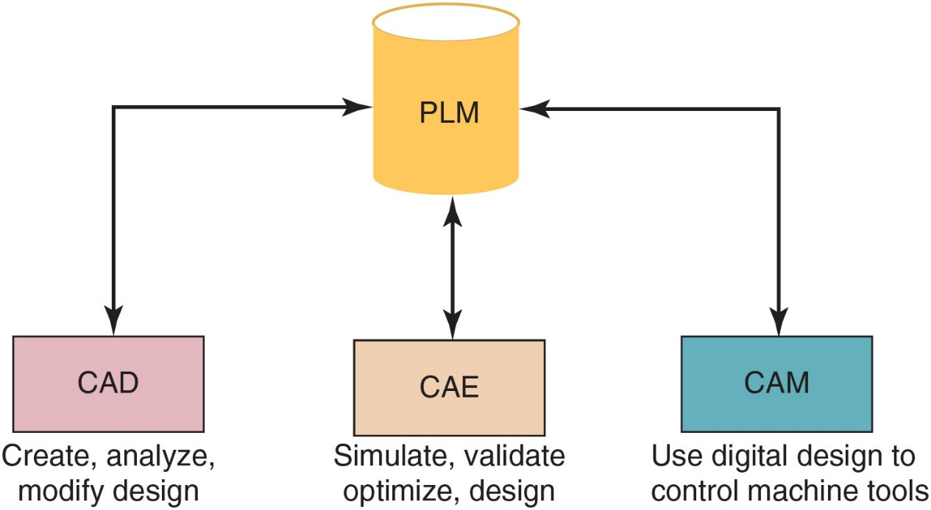
Product Lifecycle Management (PLM)
CAD, CAE, and CAM software
In manufacturing, the model generated in CAD and verified in CAE can be entered into CAM software, which then controls the machine tool.

Slide 38
Product Lifecycle Management (PLM)
Discrete manufacturing
Production of distinct items (e.g., autos, airplanes, furniture, or toys) that can be decomposed into their basic components
Process manufacturing
Production of products that are the result of a chemical process (e.g., gasoline and pharmaceutical drugs) and that cannot be easily decomposed into its basic components

Slide 39
Overcoming Challenges in Implementing Enterprise Systems
Tips for avoiding a failed implementation
Assign a full-time executive to manage
Appoint an experienced, independent resource to provide project oversight
Allow sufficient time to transition from the old way of doing things to the new system
Allocate sufficient time and money for training
Define metrics to assess project progress and to identify project-related risks
Keep the scope of the project well defined and contained to essential business processes

Slide 40
Overcoming Challenges in Implementing Enterprise Systems
Be wary of modifying the enterprise system software to conform to your firm’s business practices
Focus on documenting existing workflows before implementing and working directly with key stakeholders
Keep in mind that the best systems require little change to existing workflow as it relates to user input/effort while eliminating the biggest pain points

Slide 41
Activity
What is the goal of a customer relationship management (CRM) system? Discuss the benefits of CRM software.
Describe product lifecycle management (PLM) software and identify the type of data stored in such a system.
Determinine the risk that an ERP implementation project will fail. What organizational characteristics will you focus on?

Slide 42
Activity
Many of the benefits of an ERP can be realized through the implementation and change process. How can updating and integrating processes and activities, as part of an ERP implementation, provide benefits to the organization? Provide specific examples.
Assume that you are the owner of a small bicycle sales and repair shop serving hundreds of customers in your area. Identify the kinds of customer information you would like your firm’s CRM system to capture. How might this information be used to provide better service or increase revenue? Identify where or how you might capture this data.

Slide 43
What Happens Next?
In the next session we look at Business Intelligence and Analytics, Chapter 6.

Slide 44
Bibliography
Stair, R. and Reynolds, G. 2020. Principles of Information Systems. 14th edition. Cengage Learning. Chapter 10.

